Slide 1






GASGUARD - INTELLIGENT LPG LEAK
DETECTION AND ALERT SYSTEM
TEAM MEMBERS
M.RAKSHITHA(23619124) S.LOCHANA(23619136)
INTERNAL GUIDE
Dr. G.REVATHY M.E ,Ph.D.,

Slide 2
Abstract
LPG leakage can cause serious accidents if it is not detected and controlled at the right time. GasGuard is designed for real-time LPG leakage detection and monitoring using an MQ-2 gas sensor. The system first checks the sensor’s working condition before processing the gas readings. Based on predefined threshold values, the detected LPG concentration is classified into safe or warning and critical levels. The system displays the detected gas level and status on an OLED display. The proposed system also provides the foundation for automatic regulator shutoff and exhaust fan activation during dangerous leakage conditions, improving LPG safety through timely detection and response.

Slide 3
PROBLEM STATEMENT
LPG gas leaks in homes and other places can go unnoticed and lead to serious accidents like fires or explosions. Most current systems don't monitor gas levels in real time or respond automatically when a leak happens. There is also no way to check if the gas sensor is working properly, and users often don't know when the cylinder is about to run out. This creates a need for a smart system that can detect leaks early, confirm the sensor is working, and automatically take safety actions like cutting the gas supply, turning on ventilation, and alerting people nearby.

Slide 4
OBJECTIVES
PHASE 1:
To detect LPG gas leakage in real time using the MQ-2 gas sensor
To check the health/working condition of the gas sensor before relying on its readings. To analyze the severity of the gas leak and classify it as safe or warning.
To automatically turn OFF the gas regulator when a dangerous leak level is detected. To automatically turn ON an exhaust fan to remove the accumulated gas.
PHASE 2:
To alert people nearby using a buzzer/siren during an emergency.
To monitor the LPG cylinder level using a load cell and provide a refill warning. To build a low-cost, practical, and reliable safety system for homes, hotels, and restaurants.

Slide 5

LITERATURE SURVEY
S.NO 1
TITLE & YEAR
LPG GAS LEAKAGE DETECTION USING
IOT - 2020
AUTHOR
Dr. Chetana Tukkoji Mr.
Sanjeev Kumar A. N
LIMITATION
The authors also mention that
the system mainly focuses on leakage detection and alerting, with scope to improve gas- concentration measurement and make it more practical and cost-effective.
PROPOSED
IoT-based LPG leakage detection using MQ-5/MQ-6 gas sensor, Arduino, GSM module, exhaust fan, LED, buzzer, and a stepper motor to turn OFF the cylinder regulator. The system also sends leakage information to a website/application for monitoring.
2
An IOT- Based Gas Leakage Detection Bot- 2023
Ashwini Prasad S, Supriya K
Limited battery capacity and
limited gas-concentration
analysis; further
improvements are needed for
longer operation and practical industrial deployment.
Arduino-based LPG leakage
detection with MQ-2 sensor +
buzzer + exhaust fan + servo-
based automatic
Regulator cutoff.
IoT-based LPG leakage
detection with automatic
regulator OFF, exhaust fan,
buzzer, LED, GSM and
web/application monitoring.
3
LPG Gas Leakage Detection System with Auto Cutoff Regulator using Arduino -2024
Dr. William Thomas H M1 ,
Alex Stefan Doraiswamy2 , C
Balaji Nanda3 , Gowtham
Reddy B4 , H Pavan Kumar5
No implemented sensor health check, multi-level gas severity analysis, LPG cylinder weight monitoring, or advanced IoT monitoring.

Slide 6

S.N O
TITLE & YEAR
AUTHOR
LIMITATION
PROPOSED
4
Efficacious L.P.G.Leakage Detector and Auto Shut-Off System Using Arduino Uno AT mega328 - 2017
Abhishek Gupta
Fixed threshold detection,
local alerting, no sensor-
Arduino-based LPG
leakage detection using
health check, no LPG weightMQ-6 + automatic solenoid
monitoring, and no
IoT/cloud monitoring. Sensor warm-up also takes about 1.5–2 minutes.
valve shut-off + audible
alarm + LCD.
5
Intelligent IoT-Based Fire and Gas Leakage Detection System: Integrating Sensor Fusion, Edge AI, and Visual Verification -2026
Mohammad Altamash Mohd Rayyan
Siraj Ahmed Khan Hina Parveen
No automatic LPG regulator cutoff or LPG cylinder weight/refill monitoring; cloud-based image/data services introduce network dependence.
ESP32-based intelligent fire and gas detection using sensor fusion, Edge AI, Decision Tree classification and ESP32-CAM visual verification.

Slide 7
RESEARCH GAP
Existing LPG leakage detection systems mainly rely on fixed threshold-based detection.
False alarms may occur due to cooking fumes, smoke, environmental fluctuations, and sensor drift. Many systems provide detection and alerts but have limited integration of automatic safety actions such as regulator cutoff and exhaust control.
Sensor health monitoring before gas-level analysis is not clearly addressed in the reviewed systems. IoT-based systems can be affected by network dependency when connectivity is unavailable. Comprehensive accuracy and reliability testing under different gas concentrations and environmental conditions is limited.
Hence, there is a need for a low-cost, reliable, integrated LPG safety system with sensor health checking, severity classification, automatic regulator cutoff, exhaust control, and alert mechanisms.

Slide 8
PROPOSED METHODOLOGY
1. MQ-2 LPG Sensor
The MQ-2isagas sensor used to detect LPG and combustible gases. It senses the concentration of LPG in the air and
gives an electrical signal to the ESP32.
2. ESP32
ESP32 is the main controller of the system. It receives data from the MQ-2 and load cell, processes the data, identifies the leakage severity, and controls the alarm and safety devices.
3. Regulator Cutoff
WhendangerousLPG leakage is detected, the ESP32 activates it to stop the LPG supply.
4 Exhaust Fan
.
The exhaust fan helps remove leaked LPG from the surrounding area and improves ventilation. It is activated when the leakage reaches a high level.
5. LED
LEDs provide visual indication of the system condition. For example, green for Safe, yellow for Warning, and red for Dangerous/Critical.

Slide 9
PROPOSED METHODOLOGY
6 Resistors
.
Resistorsare used to control current and protect electronic components, especially LEDs and ESP32 GPIO pins.
7 Power Supply
.
Thepowersupply provides the required electrical power to the ESP32, sensors, and other components.
8 Jumper Wires
.
Jumperwiresare used to connect the different electronic components together during circuit construction.
9 Breadboard
.
Abreadboard allows us to build and test the circuit without soldering. It is useful during the prototype development stage.

Slide 10
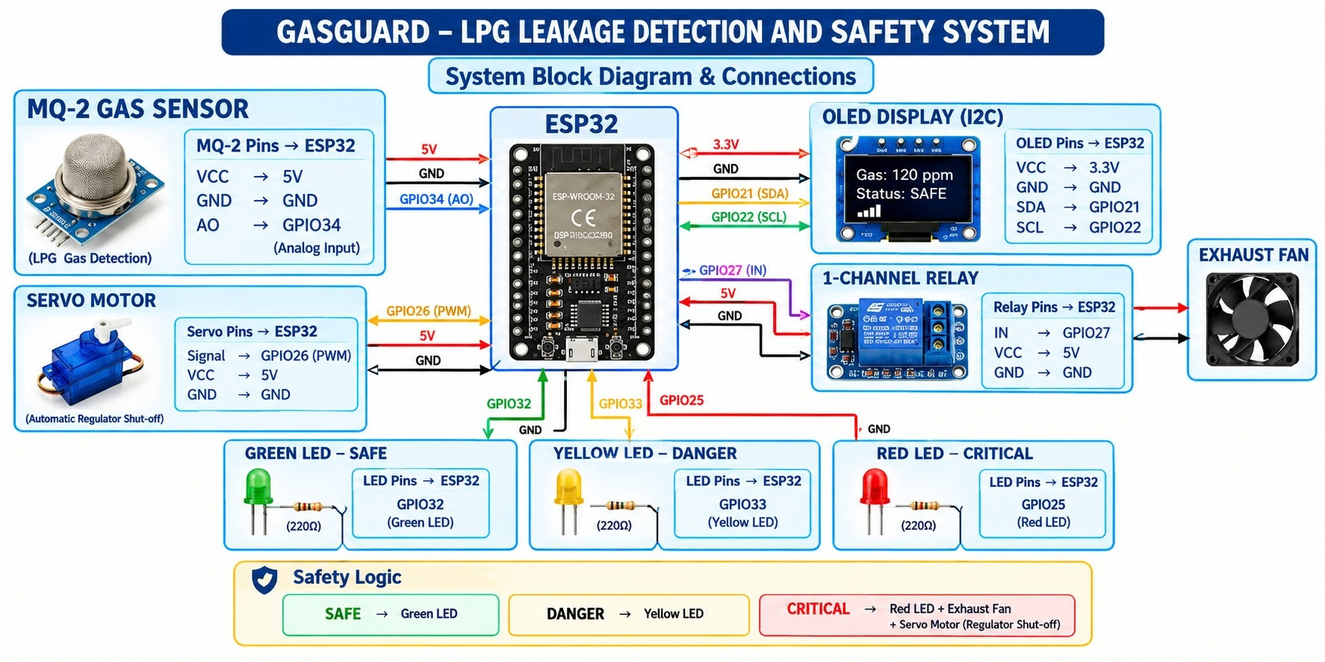
SYSTEM ARCHITECTURE

Slide 11
HARDWARE REQUIREMENTS
ESP32 Development Board
– Main controller
MQ-2 Gas Sensor
–Detects LPG leakage
Servo Motor Exhaust Fan Relay Module
–Automatically turns the LPG regulator to the OFF position –Removesaccumulated gas
–Controlsthe exhaust fan
–IndicateSafe,Warning and Dangerous conditions
LEDs
OLED/LCD Display
–Displays system status
LPG Regulator
– Project setup

Slide 12
SOFTWARE REQUIREMENTS
Arduino IDE Embedded C/C++ ESP32 Board Package
–ESP32programming
–System programming
–ESP32 development support
Arduino Libraries relay control
Serial Monitor
–MQ-6, HX711, Servo, OLED/LCD and
–Sensorreading and debugging

Slide 13
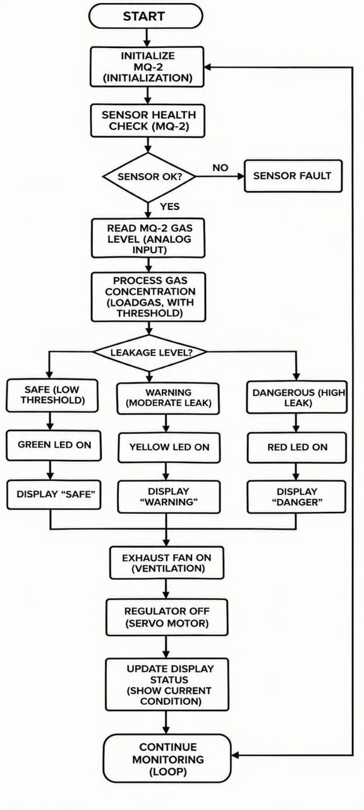
SYSTEM DESIGN
FLOWCHART

Slide 14
MODULE WISE IMPLEMENTATION PROGRESS
1)MQ-2 SensorHealthChecking:
The MQ-2sensoris checkedto verifythat it is functioning correctly.
2)LPG Gas Testing:
Agaslighteris used as a controlled LPG source to expose the MQ-2 sensor to LPG gas.
3)Gas Detection: 4)Threshold Comparison: system.
TheMQ-2detects the change in gas concentration and provides the sensor output to the ESP32.
TheESP32 compares the detected gas value with the predefined threshold values programmed in the
5)Gas Status: 6)OLED Display: 7) EXHAUST FAN:
Thegas condition is determined based on the threshold comparison.
The detected gas status/value is displayed on the OLED display in real time.
It removes the accumulated gas and gives ventilation

Slide 15
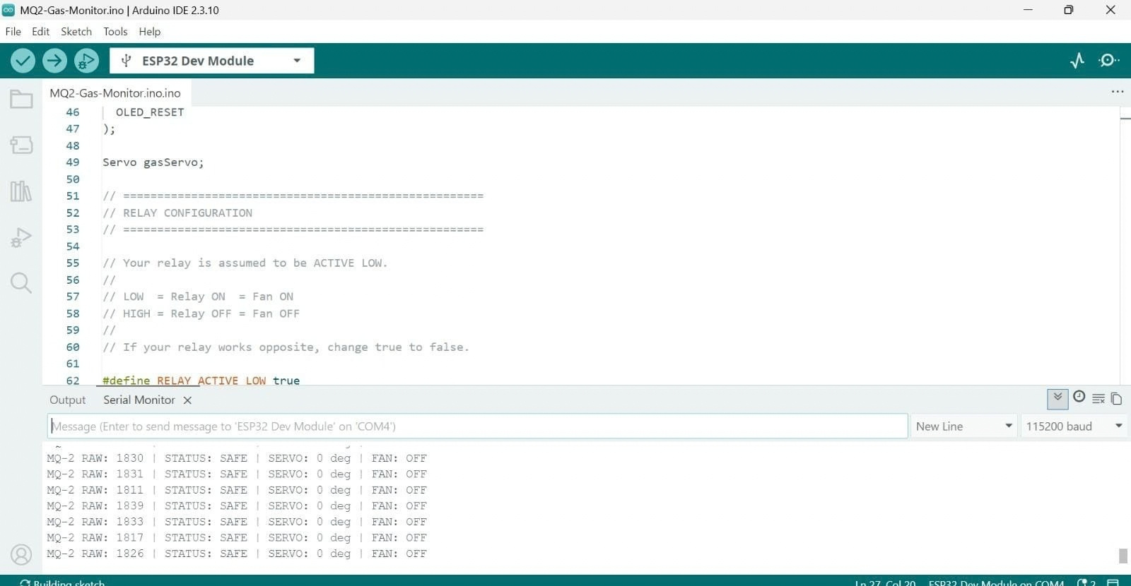
PROTOTYPE/SCREENSHOT/WORKING DEMONSTRATION

Slide 16
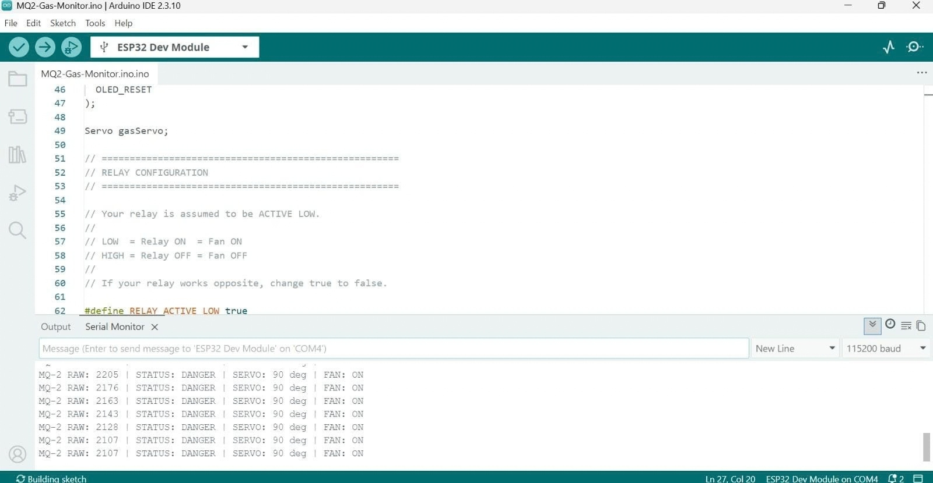
PROTOTYPE/SCREENSHOT/WORKING DEMONSTRATION

Slide 17
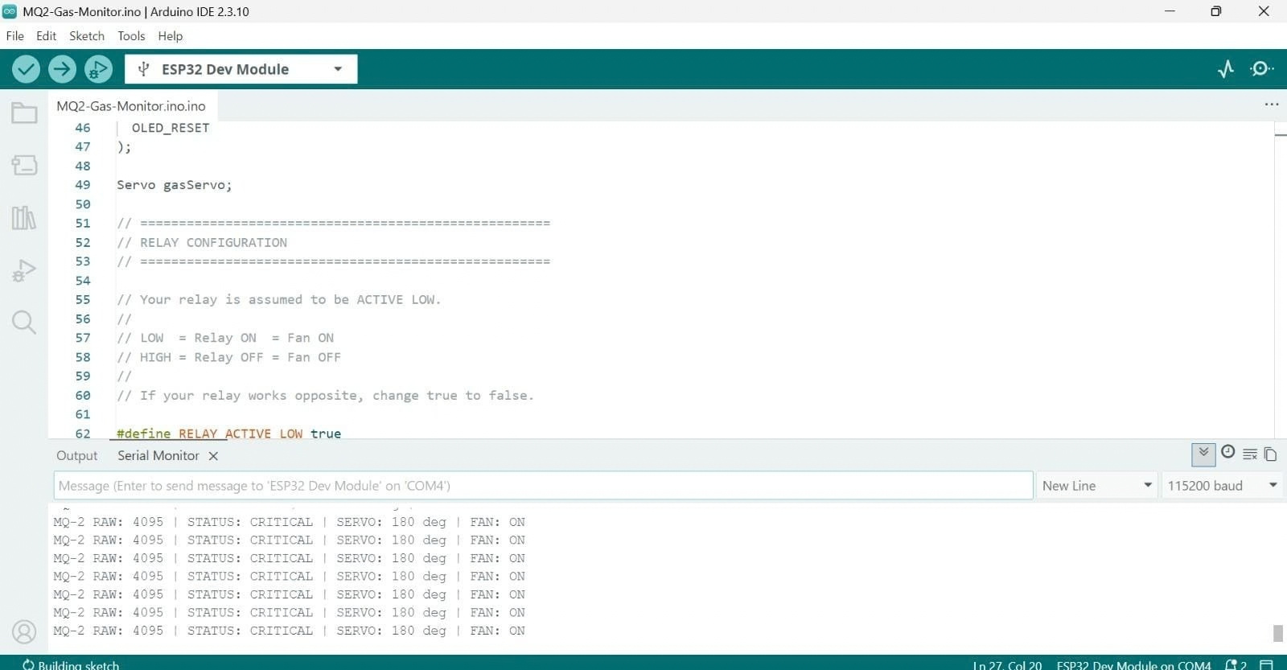
PROTOTYPE/SCREENSHOT/WORKING DEMONSTRATION

Slide 18
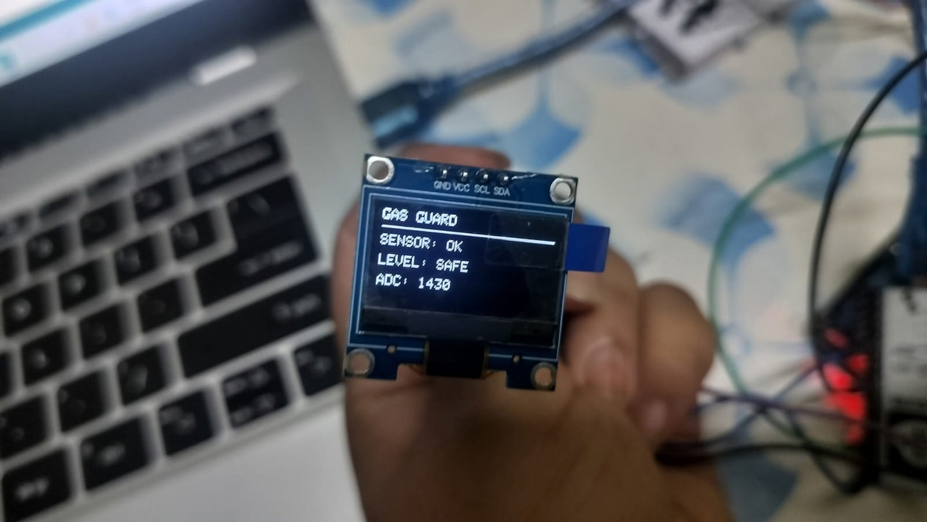
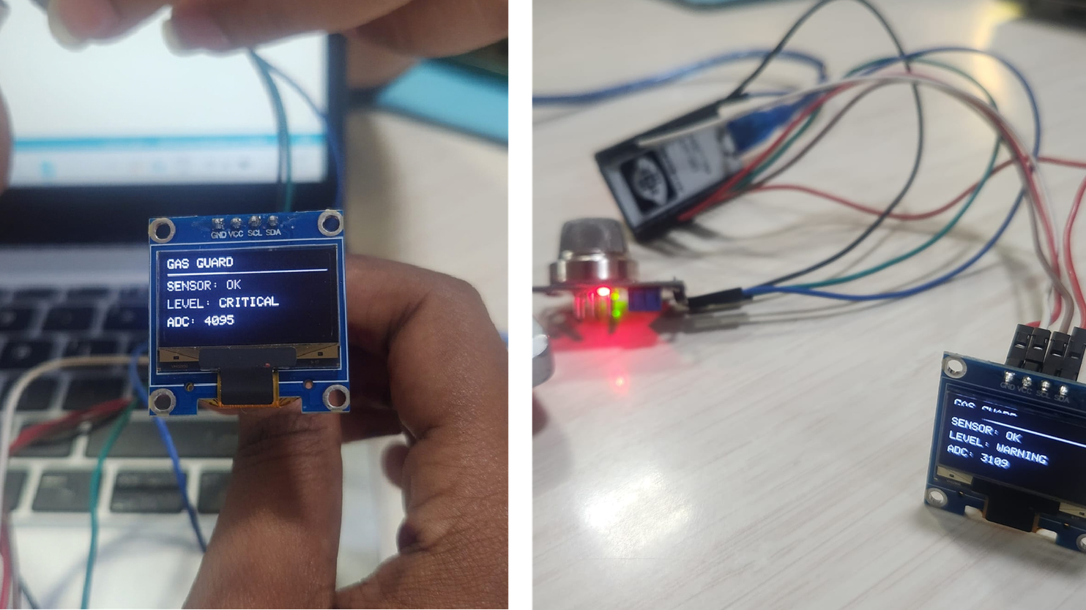
PROTOTYPE/SCREENSHOT/WORKING DEMONSTRATION
FIG1 : SAFELEVEL
FIG2 : CRITICALLEVEL
FIG3 : WARINGLEVEL

Slide 19
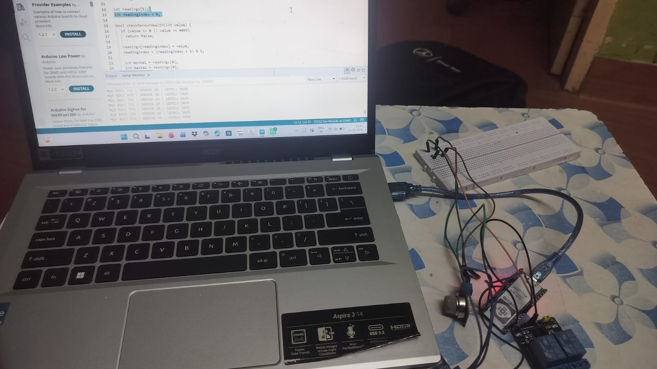
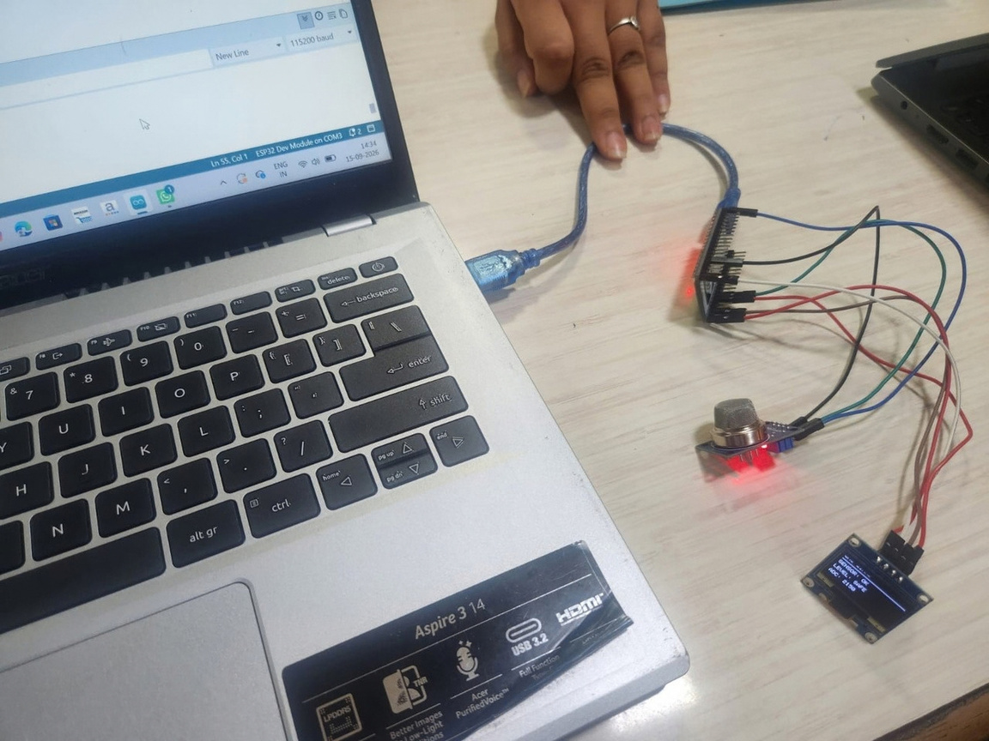
PROTOTYPE/SCREENSHOT/WORKING DEMONSTRATION

Slide 20
TESTING PROGRESS & CHALLENGES FACED
Testing Progress
MQ-2 sensorhealth checking was successfully tested.
LPG gas detection was tested using a gas lighter as the LPG source. Sensor readings were compared with predefined threshold values. ESP32 successfully processed the MQ-2 sensor output.
Gas level/status was displayed on the OLED display in real time.
ChallengesFaced
Obtaining stable MQ-2 sensor readings during testing. Providing sufficient sensor warm-up time before testing. Maintaining consistent gas exposure during testing.

Slide 21
JOURNAL/IEEE CONFERENCE TOC
I . INTRODUCTION
II. literature survey
III. RESEARCH GAP
IV. PROPOSED METHODOLOGY
V.SYSTEM IMPLEMENTATION
VI.CONCLUSION AND FUTURE ENHANCEMENTS VII.REFERENCES

Slide 22
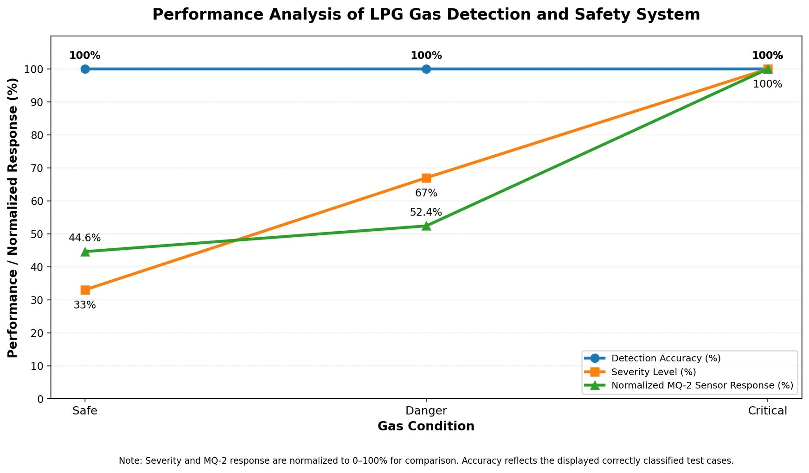
PERFORMANCE ANALYSIS

Slide 23

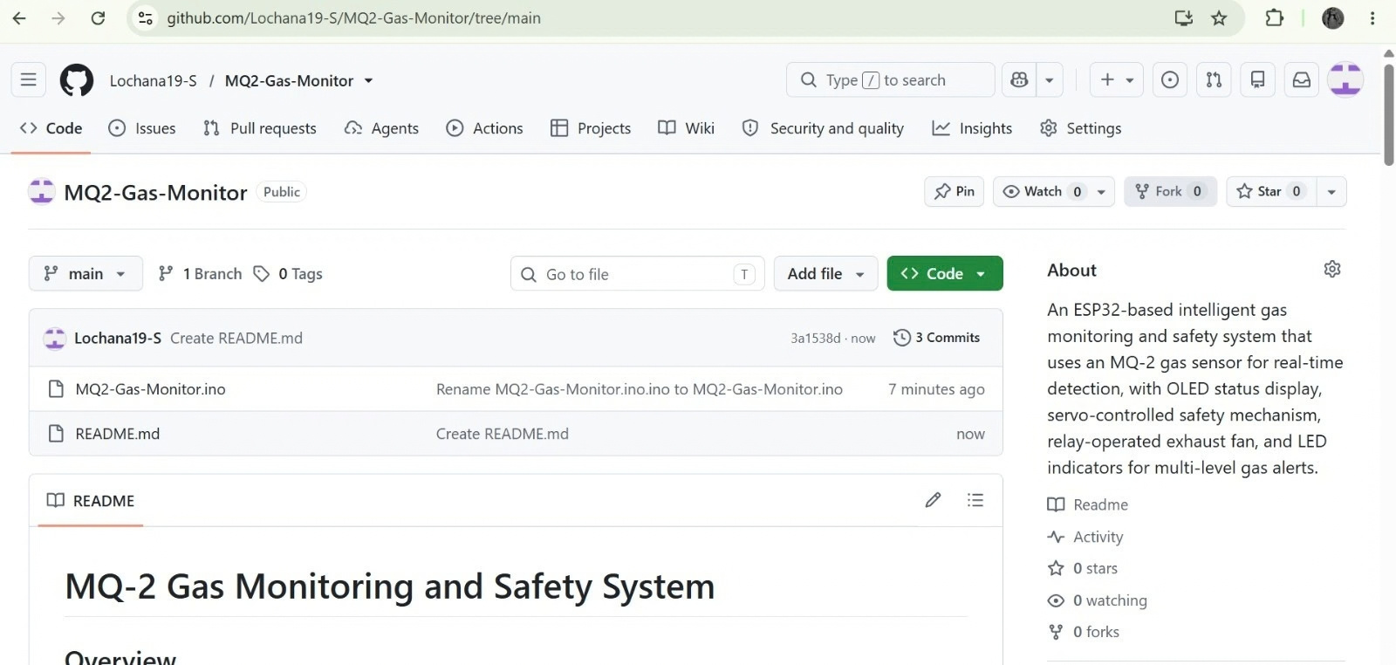
GITHUB CODE SUBMISSION

Slide 24
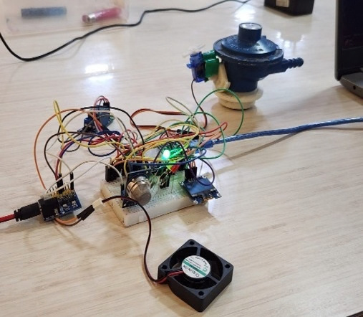
EXPERIMENTAL SETUP

Slide 25

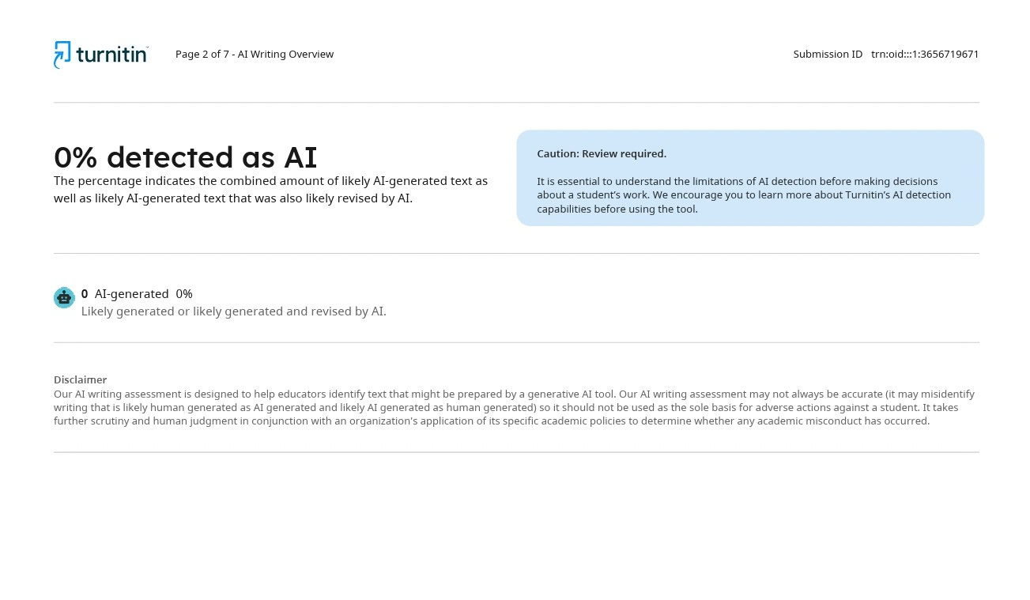
PLAGIARISM TEST REPORT

Slide 26
THANKYOU!!

